Slide 1
Chapter 20: Transaction (cont.) & Chapter 21: Concurrency Control

Slide 2
Implementing Transaction Processing using REDO logs
Deferred update/write and Redo log:
The update/write operation is deferred and
the log used is a REDO log
Recall: what is deferred write (update)
An deferred update operation will NOT make the updates immediately to the database
The updates are made after the transaction has completed successfully
When transaction T₁ updates the data item X (deferred), but has yet not completed and in the mean time, a transaction T₂ reads the data item X , then T₂ will read the OLD value of X

Slide 3
Implementing Transaction Processing using REDO logs
Redo log:
A REDO log is a log file that contains information to REDO the effect of transactions
A effect of a transaction means changing values in some records in the database
To redo the effect of a transaction is to redo the updates made by the transaction
In order to redo the updates made by the transaction, we save the NEW value of every updated data item !!!

Slide 4
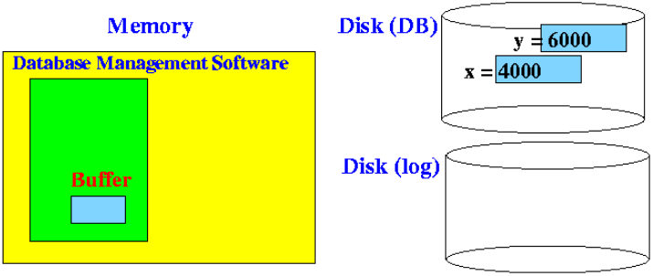
Example Transaction Processing using Deferred Write and Redo Logs
Consider a simple transaction T that updates a value x:
Initially, the database state is as follows:
T: x = x – 1000
y = y + 1000
E.g., transfer $1000 from bank account x to y

Slide 5
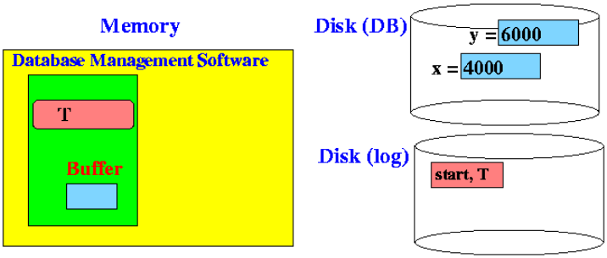
Example Transaction Processing using Deferred Write and Redo Logs
Step 1: when transaction T starts, the transaction processing system writes a start transaction to log file:

Slide 6
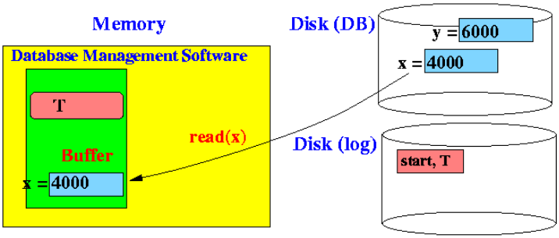
Example Transaction Processing using Deferred Write and Redo Logs
Step 2: Transaction T must read the data item x from disk into its memory buffer:

Slide 7
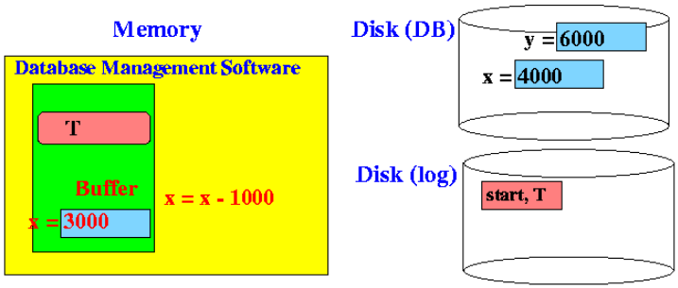
Example Transaction Processing using Deferred Write and Redo Logs
Step 3: To update data on disk , the transaction only update the data item x in its memory buffer

Slide 8
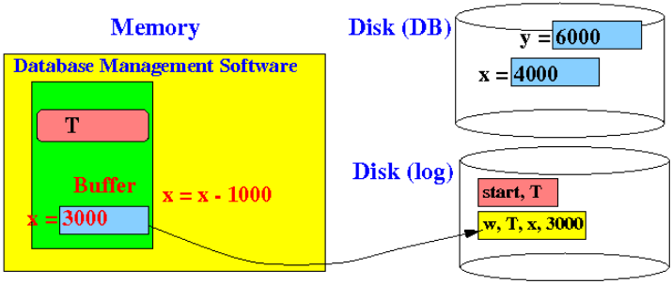
Example Transaction Processing using Deferred Write and Redo Logs
Step 3 (cont.): After updating, transaction also write a REDO record to the log
Notice that the new value of x is written to the log.
The log must be written before the transaction commits

Slide 9
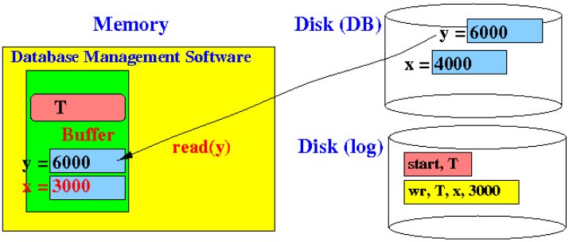
Example Transaction Processing using Deferred Write and Redo Logs
Step 4: Transaction T then read y from disk into its memory buffer

Slide 10
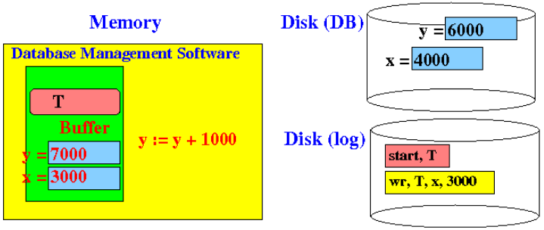
Example Transaction Processing using Deferred Write and Redo Logs
Step 5: Transaction T only update the data item y in its memory buffer

Slide 11
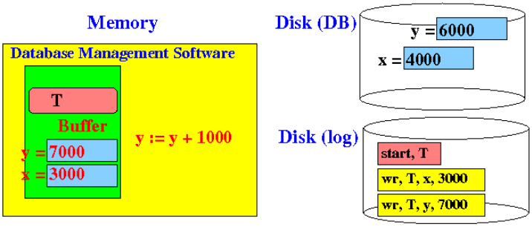
Example Transaction Processing using Deferred Write and Redo Logs
Step 5 (cont.): after updating, transaction also write a REDO record to the log

Slide 12
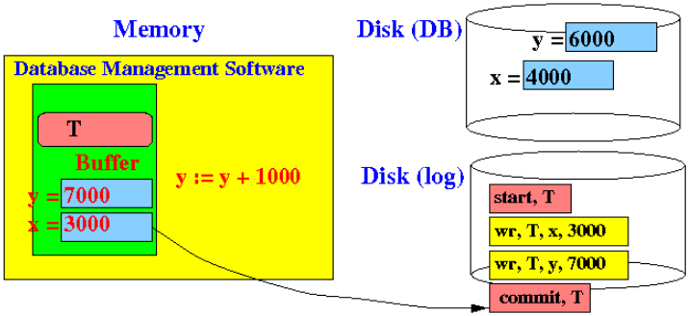
Example Transaction Processing using Deferred Write and Redo Logs
Step 6: Finally, transaction T completes:
First: write commit record

Slide 13
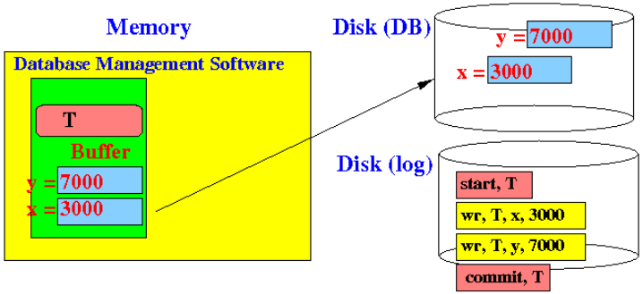
Example Transaction Processing using Deferred Write and Redo Logs
Step 6 (cont.): Finally, transaction T completes:
Only then update database:

Slide 14
How Deferred Write + Redo Log Ensures Atomicity
Recall that the execution of a transaction is atomic:
Either everything is done (i.e., both x and y are updated)
Or else nothing is done (i.e., both x and y are NOT updated)
Question:
What can cause partial execution?
Answer:
System failure

Slide 15

How Deferred Write + Redo Log Ensures Atomicity
Consider a system failure occurred at some step in the above execution:
Case 1: System failed any time before step 6 is complete:
There is NO commit record !
x and y were unchanged
no problem: discard log data of any uncommitted transactions

Slide 16

How Deferred Write + Redo Log Ensures Atomicity
Consider a system failure occurred at some step in the above execution:
Case 2: System failed during step 6:
There is a commit record !
Redo transaction using the redo log !

Slide 17
Chapter 21: Concurrency Control

Slide 18
Intro to Concurrency Control
Fact:
Concurrent execution of transactions can cause the database state to become inconsistent
See example:

Slide 19
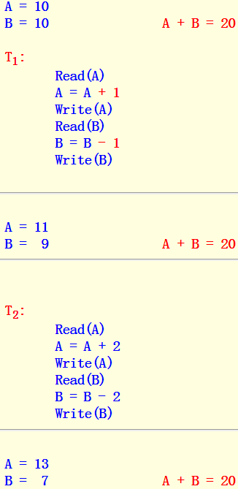
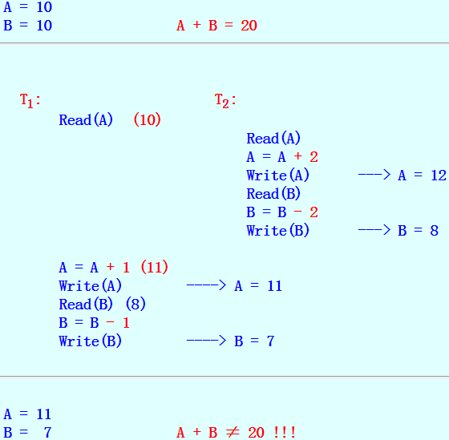
Non-concurrent execution:
Concurrent execution:

Slide 20
Concurrency Control
Concurrency control = the general process of assuring that: :
A concurrent execution of the actions in (multiple) transactions will preserve the consistency of the database
When is a concurrent execution of transaction correct ???
Serializability

Slide 21
Definition of Schedule
A definition: schedule
Schedule = a sequence of (important) steps taken by one or more transactions
In concurrency control, the important steps made by transactions are:
read operations (Read(X))
write operations (Write(X))
See example of different schedules:

Slide 22
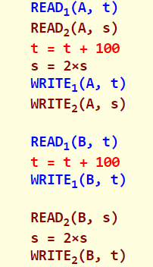
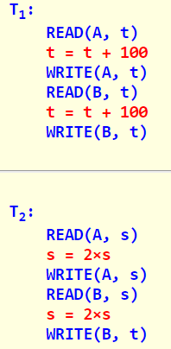
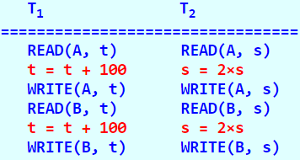
Example of Schedule
We have 2 DB elements:
Example of a schedule:
When T₁ or T₂ are executed in isolation:
A = 25
B = 25 (A = B)
We have 2 transactions:
Subscript indicate the transaction

Slide 23
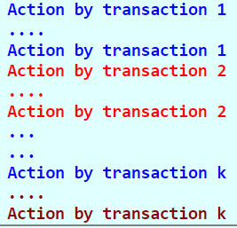
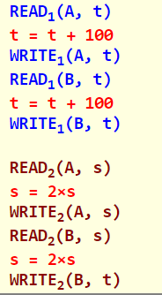
Serial Schedule
A definition: serial schedule
Serial schedule = a schedule where the actions of the same transactions are group together
A serial schedule looks like this:
Example: serial schedule

Slide 24
Database Consistency and Serial Schedules
Fact:
A serial schedule executes each transaction in isolation
Therefore:
Every serial schedule will preserve the consistency (correctness) of the database
Conclusion:
We can use a serial schedule as the basis for the definition of correctness for:

Slide 25
Serializable Schedule
A schedule S is serializable schedule iff:
There is a serial schedule S' such that:
In other words,
Starting in any DB state, executing the schedules S/S' will result in the same DB state
See example:

Slide 26
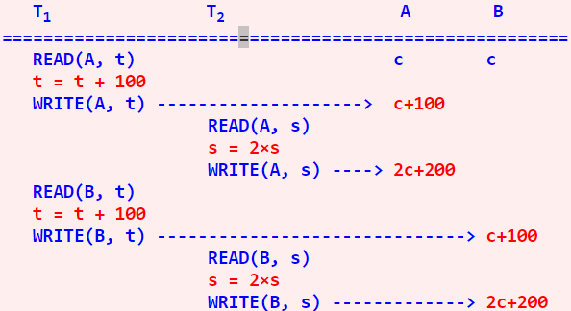
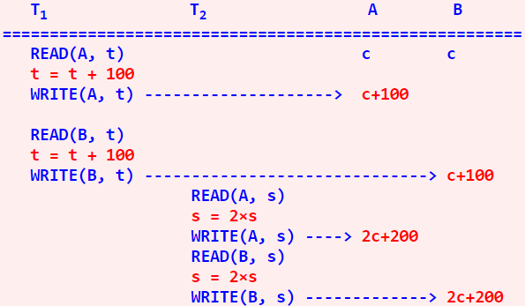
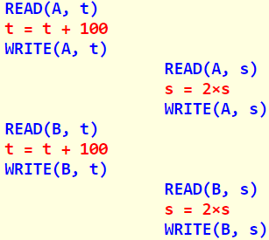
Example: serializable schedule
The schedule is therefore serializable
is equivalent to the following serial schedule:
Observe that: The interleaved execution (schedule):

Slide 27
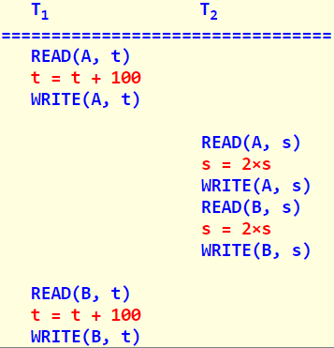
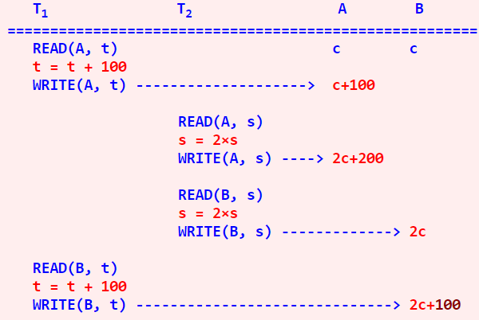
Non-serializable Schedule
Consider the following schedule:
The execution will result in an inconsistent database state:

Slide 28

Non-serializable Schedule
At the end of the execution, we have:
This result can never be obtained by a serial execution of T₁ and T₂ !!!!
Therefore:

Slide 29
Intro to Locks
A technique to enforce serializable schedule
Fact:
Uncontrolled access to DB elements will result in non-serializable behavior
Locks can alter the order of the execution of operations:
By denying a request for a lock, we can alter the order of the execution of certain operations !!!
Goal:
Define grant/deny rules so that the modified order of operations is serializable

Slide 30

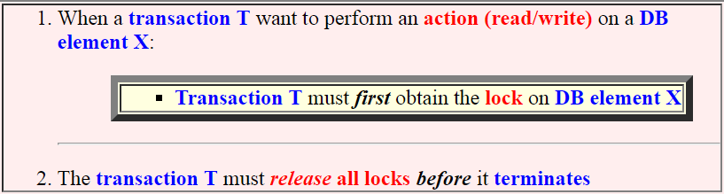

Exclusive Locks
Notation:
Locking rules for exclusive locks
Schematically:

Slide 31
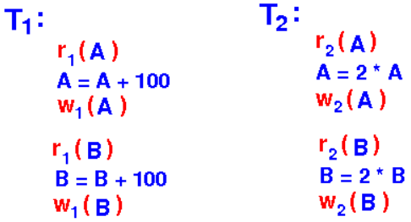
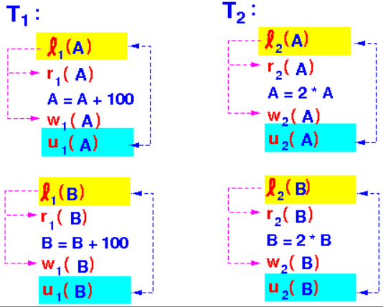
Example of Locking
Transactions:
Transactions augmented with lock operations:

Slide 32
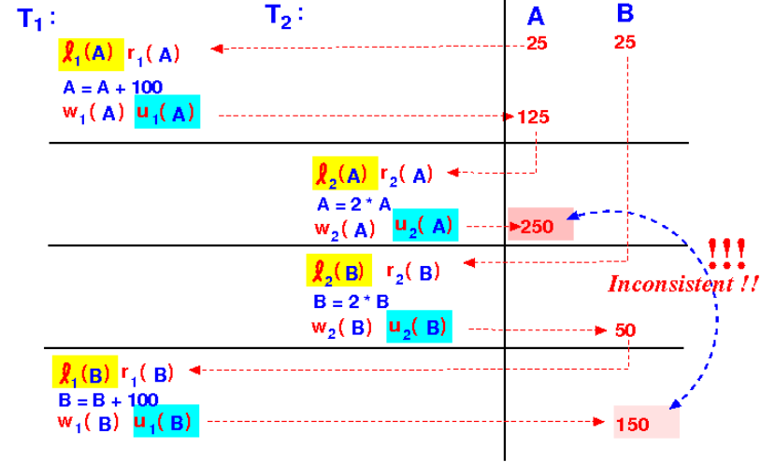

Example of a Schedule with Locks
Notice that:
The transactions obeys the locking rules:
However:
The resulting schedule is non-serializable
(Because serial schedules of transactions T₁ and T₂ will preserve the property A = B !!!)

Slide 33
Example of a Schedule with Locks
Conclusion:
The locking rules is insufficient to ensure serializability !!!

Slide 34
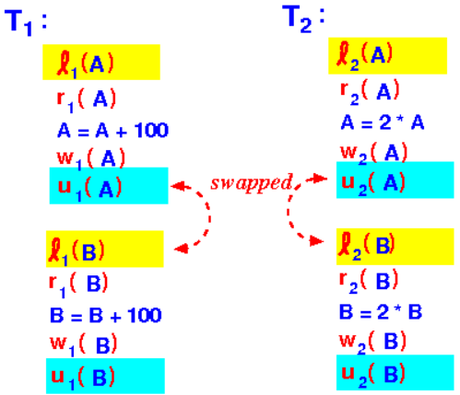
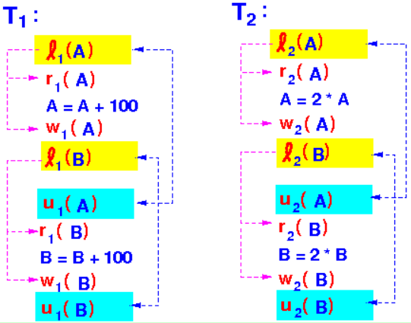
Example 2 of Locking (with a Correct Outcome!)
Consider a slightly changed order in the transactions:
We re-order these 2 unlock/lock operations in the previous example:
Result:

Slide 35
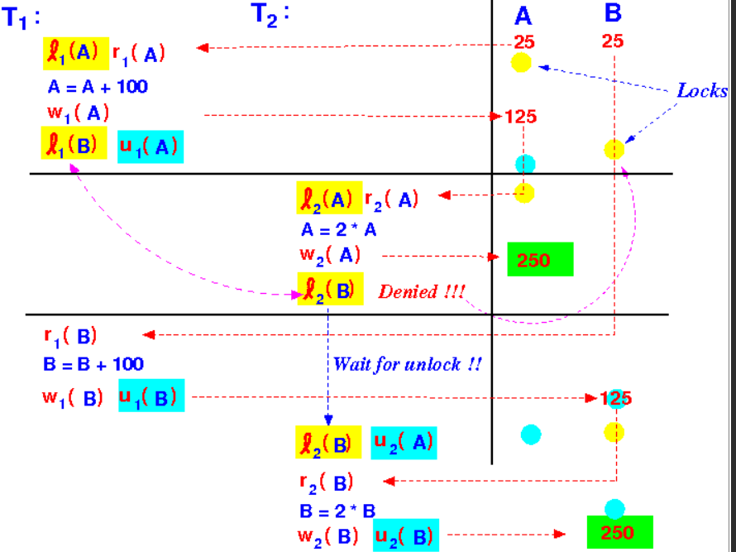
Example 2 of Locking (with a Correct Outcome!)
Now consider the execution of the same schedule:

Slide 36

Example 2 of Locking (with a Correct Outcome!)
Conclusion:
The execution results in a consistent state !!!
So locks can force a schedule to change the order of execution of the actions so that:
Question:
The resulting execution of the schedule is serializable
What is the secret ingredient that we need to add to make locking a sufficient technique to ensure serializability ????

